Slide 1
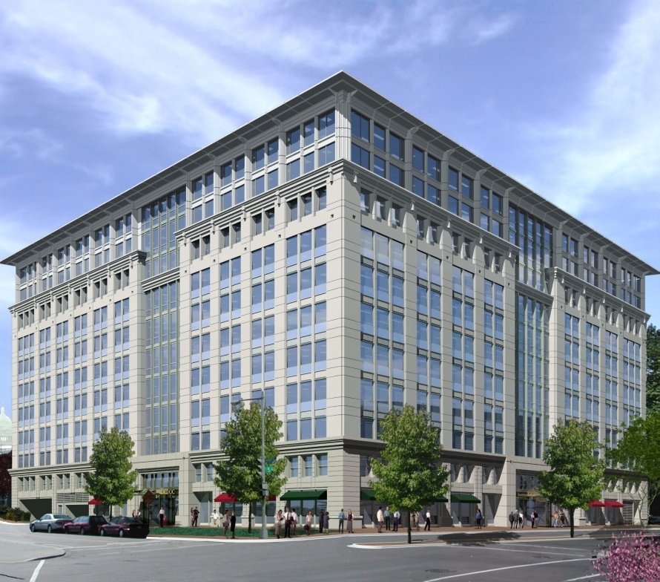
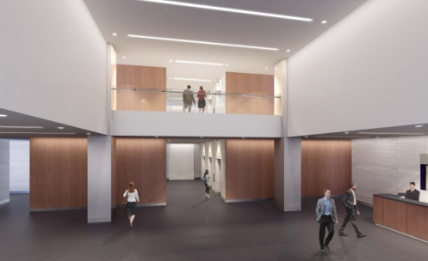
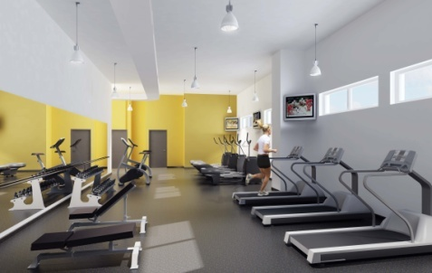
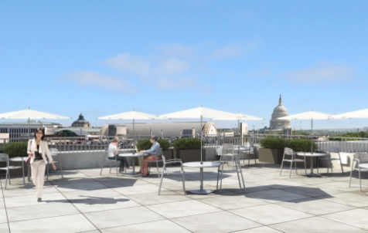
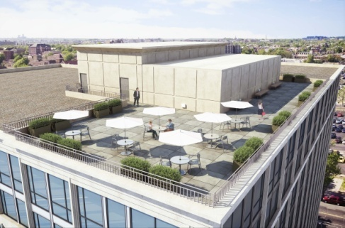
77 K STREET
Washington, DC
Todd Povell
Construction Management
Penn State AE Senior Thesis 2008

Slide 2

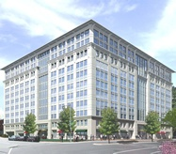
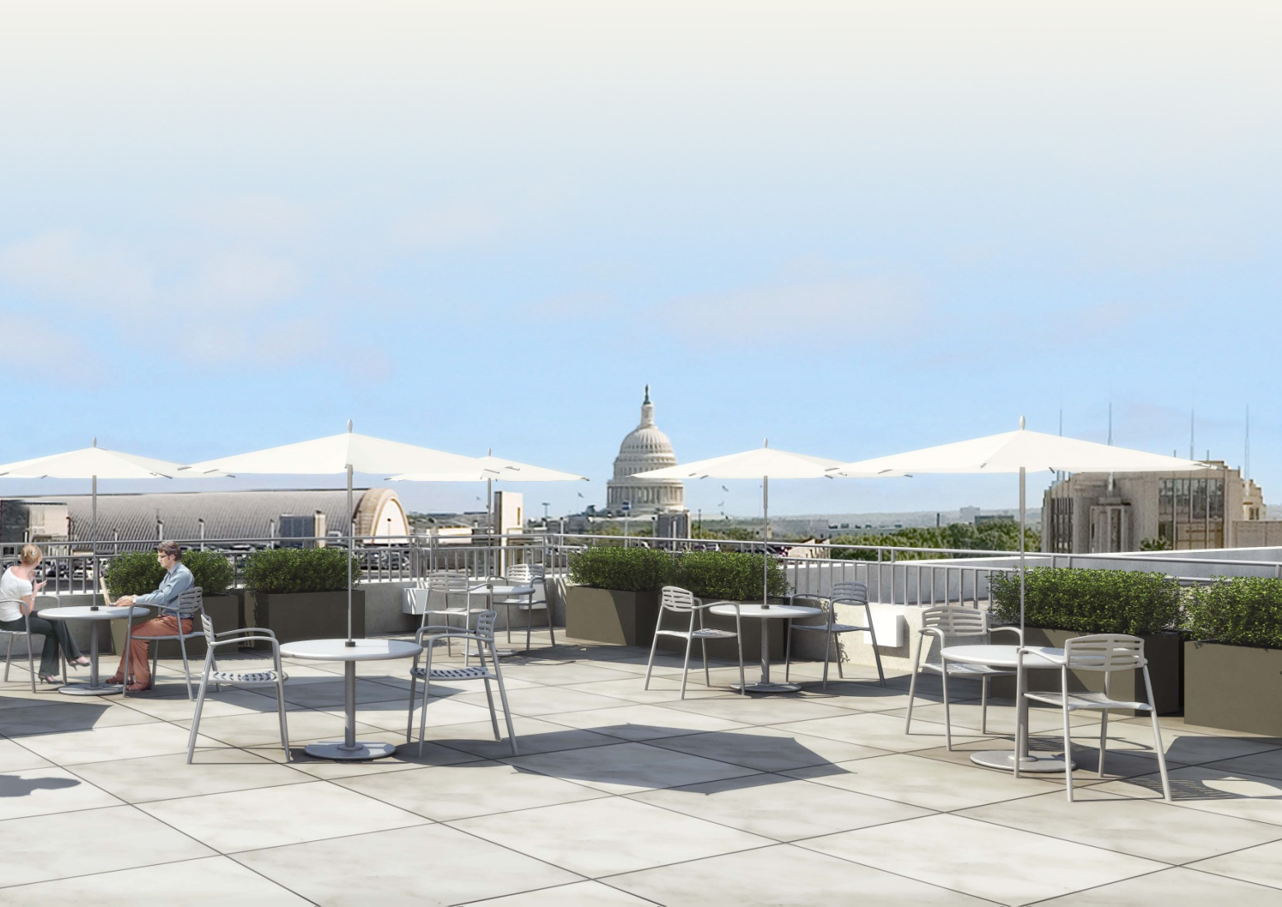
77 K STREET
Washington, DC
Todd Povell
Construction Management
Penn State AE Senior Thesis
• Project Overview
• Current LEED Status
• LEED Accreditation Owner Assessment
• Glazing Alternative Analysis
• Green Roof Addition Analysis
• Potential Financial and LEED Status
• Questions

Slide 3

Project Overview
LEED Status
Owner Assessment
Glazing Analysis
Green Roof Analysis
Potential Status
Questions
Function:
Size:
Levels:
Construction Schedule:
Construction Cost:
Delivery Method:
Contractual Arrangement:
Mixed Office & Retail
344,000 SF
3 Below Grade, 11 Above
Nov. 2006 – Sept. 2008
$41,000,000
Design-Bid-Build
Cost Plus Fee with a GMP

Slide 4



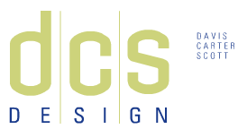
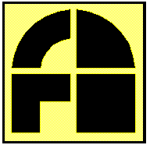
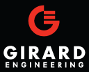
PROJECT TEAM
Owner,
50% Joint Venture
Brookfield Properties ING Clarion
Project Overview
LEED Status
Owner Assessment
Glazing Analysis
Green Roof Analysis
Potential Status
Questions
General Contractor
James G. Davis Construction Corporation
Architect
Davis, Carter, Scott
Structural Engineer
Fernandez and Associates
MEP Engineer
Girard Engineering

Slide 5
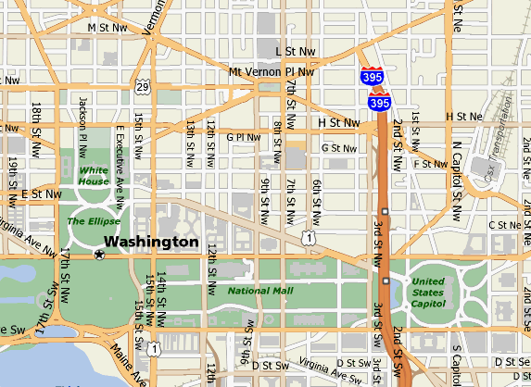
Project Overview
LEED Status
Owner Assessment
Glazing Analysis
Green Roof Analysis
Potential Status
Questions
• Less than a half mile north of Union Station (train station)
• One mile northeast of the United States Capitol Building
• Numerous public transportation routes within close proximity
• North of Massachusetts (NoMa) development district

Slide 6
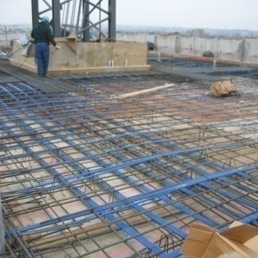
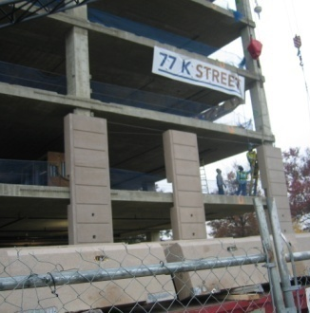
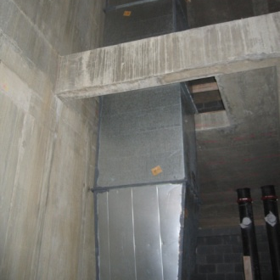
Structural System:
• 4,000 psi, 4’-0” thick mat foundation
• Below Grade: 9” reinforced flat slab
• Above Grade: 10”-11” post-tensioned two-way slab
Project Overview
LEED Status
Owner Assessment
Glazing Analysis
Green Roof Analysis
Potential Status
Questions
Façade:
• Glass curtainwall
• Insulating vision glass
• Precast concrete panels
• EIFS system at roof penthouse
Mechanical System:
• (3) Rooftop cooling towers
• Self-contained units at each typical floor
• Limited number of VAV boxes in tenant spaces

Slide 7

LEED for Core & Shell Development
Project Overview
LEED Status
Owner Assessment
Glazing Analysis
Green Roof Analysis
Potential Status
Questions
• LEED certification considered late in project planning
• LEED benchmark survey performed
• Fell short of Energy & Atmosphere Prerequisite Credit 2
• Only achieved 4.8% energy savings
• Significantly shy of 14% requirement
• Would require mechanical redesign and mechanical equipment
had already been ordered
• Idea of LEED accreditation abandoned

Slide 8
LEED for Core & Shell Development
Project Overview
LEED Status
Owner Assessment
Glazing Analysis
Green Roof Analysis
Potential Status
Questions
LEED® Green Building Rating SystemTM For Core & Shell Development, v2.0
Sustainable Sites (SS)
15 Possible Points
LEED® Accreditation:
Certified
23-27 points
Silver
28-33 points
Gold
34-44 points
Platinum
45-61 points
4
Water Efficiency (WE)
5 Possible Points
Energy & Atmosphere (EA)
14 Possible Points
Materials & Resources (MR)
11 Possible Points
Indoor Environmental Quality (EQ)
11 Possible Points
2
Innovation & Design Process (ID)
5 Possible Points

Slide 9
Commercial Office Building Assessment:
An Owner’s Perspective
Project Overview
LEED Status
Owner Assessment
Glazing Analysis
Green Roof Analysis
Potential Status
Questions
Goals:
• Assess owners’ views on LEED accreditation
• Investigate the methodology for determining whether or not to pursue
accreditation
• Determine how LEED accreditation has benefited past projects
• Compare tenant agreements between LEED projects vs. non-accredited
projects
• Assess future trends in LEED accreditation within the office building market
Resources and Tools:
• Online survey developed and distributed via SurveyMonkey.com
• Thirteen owner representative responses were collected

Slide 10
Deciding Whether or Not to Pursue Accreditation?
Project Overview
LEED Status
Owner Assessment
Glazing Analysis
Green Roof Analysis
Potential Status
Questions
PRIMARY IMPORTANCE | SECONDARY CRITERIA
Financial Analysis | Target Tenant Profile
Corporate Policy | Market Trends
Financial Analysis:
• Most common selection procedure. A cost-performance assessment is
completed to determine if in the long run, LEED accreditation is profitable.
Corporate Policy:
• All projects pursue a minimum accreditation level.
Target Tenant Profile:
• Evaluated based on known or anticipated tenant.
Market Trends:
• Based on local market and similar projects competing for the same tenant base.

Slide 11
The Current LEED Environment
Project Overview
LEED Status
Owner Assessment
Glazing Analysis
Green Roof Analysis
Potential Status
Questions
• Independent of utility agreement structure
• If landlord pays, landlord saves long term
• If tenant pays, LEED is seen as a
marketing tool
• In the current market, tenants are unwilling
to pay more, unless they demand high
accreditation levels (Gold or Platinum)
• LEED is a marketing tool
• Differentiator between similar projects
• Allows a development company to gain a
competitive advantage.

Slide 12
Tenant Evaluation
Project Overview
LEED Status
Owner Assessment
Glazing Analysis
Green Roof Analysis
Potential Status
Questions
• The larger a company, the more willing they may be to pay more for LEED space.
• Larger companies and governmental agencies may have corporate policies regarding LEED occupancy.
• Smaller, bottom-line driven companies may be less inclined to pay more to occupy a LEED space even when presented with the added benefits.
“Some tenants have a corporate awareness; even a corporate directive about occupying LEED certified buildings, at a minimum. It’s a corporate iconic statement about meeting energy and environmental obligations.”

Slide 13
Conclusions
Project Overview
LEED Status
Owner Assessment
Glazing Analysis
Green Roof Analysis
Potential Status
Questions
• LEED accreditation is only beginning to grow in popularity.
• LEED spaces are generally leased at equivalent prices to non-accredited spaces with similar features.
• Accreditation is seen as a strong marketing tool.
• It is a differentiator when a tenant considers a similar space at a similar cost that is or is not LEED accredited.
• Sustainable design is becoming more and more enticing given rising energy and fuel costs.

Slide 14

Glazing Alternative Analysis
Project Overview
LEED Status
Owner Assessment
Glazing Analysis
Green Roof Analysis
Potential Status
Questions
Problem:
• Glazing system does not minimize heat transfer through the building envelope
Solution:
• Perform a value engineering assessment to select a more efficient glazing type
that minimizes solar heat gain
• Optimize initial and life cycle operating costs

Slide 15
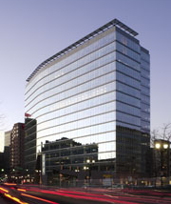
Viracon Insulating Glass Unit Glazing Options
Project Overview
LEED Status
Owner Assessment
Glazing Analysis
Green Roof Analysis
Potential Status
Questions
Glass Type | Transmittance |  |  | Reflectance |  |  | U-Value |  | SHGC | $/SF
 | Visible | Solar | U-V | Vis-Out | Vis-In | Solar | Winter | Summer
VE 1-85 | 76% | 47% | 26% | 12% | 13% | 21% | 0.31 | 0.29 | 0.54 | $13.30
VRE 1-67 | 60% | 32% | 20% | 29% | 25% | 35% | 0.30 | 0.27 | 0.37 | $13.30
VNE 1-63 | 62% | 23% | 4% | 10% | 11% | 36% | 0.29 | 0.25 | 0.28 | $14.80
VE 1-85:
Existing glazing type
Clear vision glass
Low-emissivity
High visible transmittance
VRE 1-67:
Hybrid, low- e coating
Reduced solar heat gain
VNE 1-63:
Solar performance of hybrid
Low transmittance of traditional low-e coatings
Ideal for sustainable projects
WSFS Bank Center: Wilmington, DE
Glass Type: VRE 1-67
(Source: Viracon)

Slide 16
Fenestration Heat Gain Analysis:
Q = Q_{con} + Q_{solar}
Q = UA(t_{out} – t_{in}) + SHGC(A_{pf})(E_{t})
Project Overview
LEED Status
Owner Assessment
Glazing Analysis
Green Roof Analysis
Potential Status
Questions
Step 1: Calculate Hourly Outside Temperature
• Collect sunrise, sunset data from United States Naval Observatory (USNO)
• Collect monthly temperatures data from the National Oceanic and Atmospheric Administration (NOAA)

Slide 17
Step 2: Calculate Total Surface Irradiance (E_{t})
Total Irradiance = Direct Irradiance + Diffuse Irradiance + Ground Reflected Irradiance
E_{t} = E_{D} + E_{d} + E_{r}
Project Overview
LEED Status
Owner Assessment
Glazing Analysis
Green Roof Analysis
Potential Status
Questions
E_{D}
E_{d}
E_{r}
Ground

Slide 18
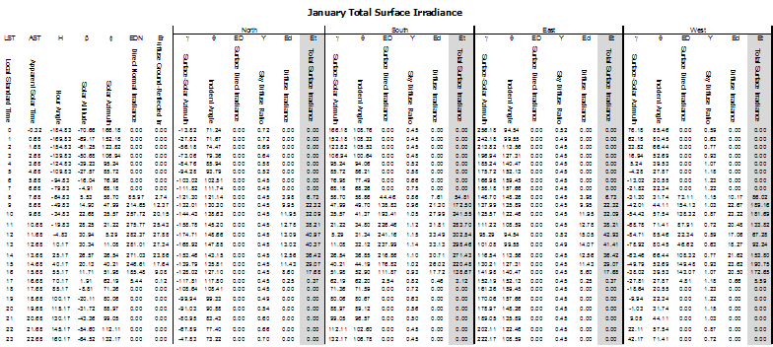
Step 2: Calculate Total Surface Irradiance (E_{t})
Total Irradiance = Direct Irradiance + Diffuse Irradiance + Ground Reflected Irradiance
E_{t} = E_{D} + E_{d} + E_{r}
Project Overview
LEED Status
Owner Assessment
Glazing Analysis
Green Roof Analysis
Potential Status
Questions

Slide 19
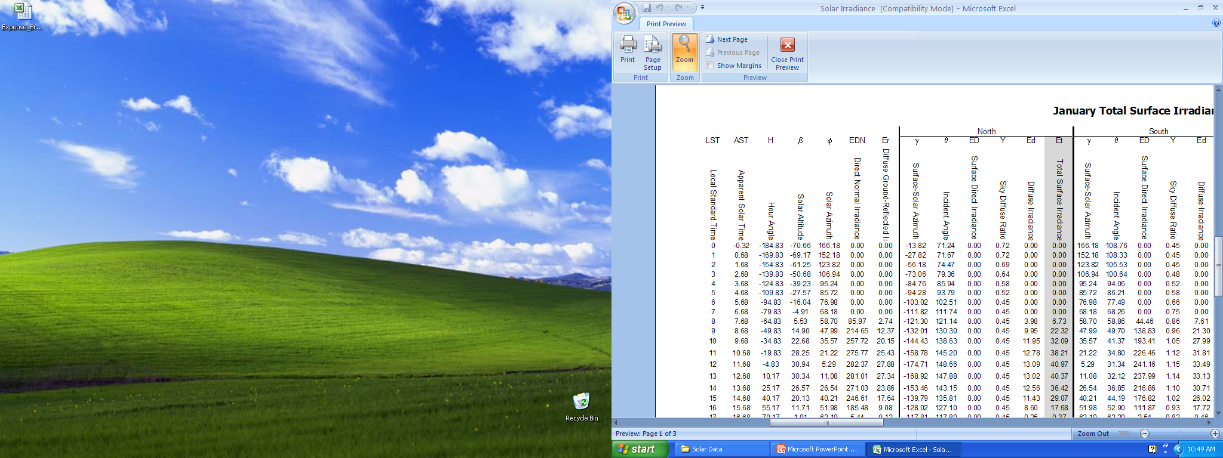
Step 2: Calculate Total Surface Irradiance (E_{t})
Total Irradiance = Direct Irradiance + Diffuse Irradiance + Ground Reflected Irradiance
E_{t} = E_{D} + E_{d} + E_{r}
Project Overview
LEED Status
Owner Assessment
Glazing Analysis
Green Roof Analysis
Potential Status
Questions

Slide 20
Step 2: Calculate Total Surface Irradiance (E_{t})
Total Irradiance = Direct Irradiance + Diffuse Irradiance + Ground Reflected Irradiance
E_{t} = E_{D} + E_{d} + E_{r}
Project Overview
LEED Status
Owner Assessment
Glazing Analysis
Green Roof Analysis
Potential Status
Questions

Slide 21
Step 3: Perform Solar Heat Gain Analysis
Q = UA(t_{out} – t_{in}) + SHGC(A_{pf})(E_{t})
Project Overview
LEED Status
Owner Assessment
Glazing Analysis
Green Roof Analysis
Potential Status
Questions

Slide 22
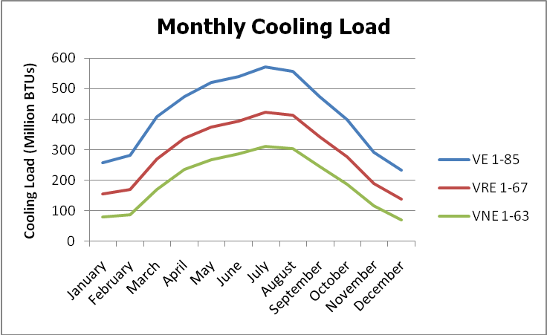
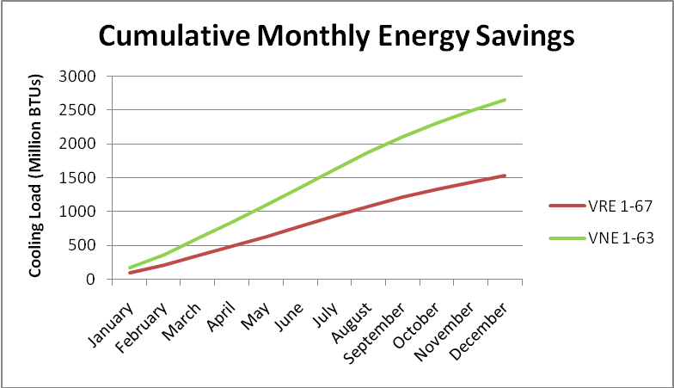
Step 3: Perform Solar Heat Gain Analysis
Q = UA(t_{out} – t_{in}) + SHGC(A_{pf})(E_{t})
Project Overview
LEED Status
Owner Assessment
Glazing Analysis
Green Roof Analysis
Potential Status
Questions

Slide 23

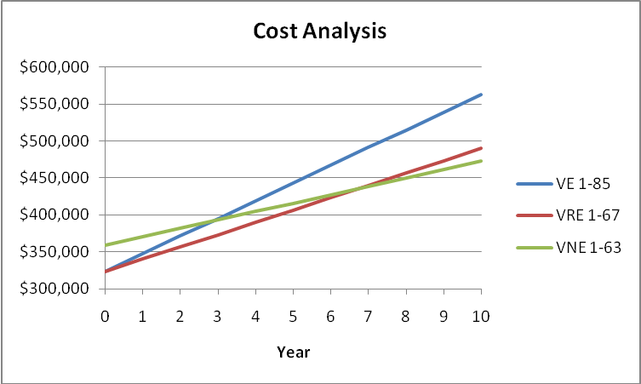
Step 4: Calculate Cooling Load Cost Savings
Project Overview
LEED Status
Owner Assessment
Glazing Analysis
Green Roof Analysis
Potential Status
Questions

Slide 24
LEED Impact:
Project Overview
LEED Status
Owner Assessment
Glazing Analysis
Green Roof Analysis
Potential Status
Questions
# of Credits | LEED Credit | Likely | Possibly | Contributor
2-8 | Energy and Atmosphere 1.0 |  |  | X
 | Optimizing Energy Performance
1-2 | Materials and Resources 4.1, 4.2 |  |  | X
 | Recycled Content
1 | Indoor Environmental Quality 8.1 | X
 | Daylight and Views
1 | Indoor Environmental Quality 8.2 | X
 | Daylight and Views
1-4 | Innovation & Design Process 1.1-1.4 |  | X
 | Innovation in Design

Slide 25
Green Roof Addition Analysis
Project Overview
LEED Status
Owner Assessment
Glazing Analysis
Green Roof Analysis
Potential Status
Questions
Green Roof Benefits:
• Reduce energy demands
• Protect the waterproofing membrane and extend its lifespan
• Contribute LEED points
• Reduce storm water runoff
• Decrease the urban heat island effect
• Increase oxygen filtration and production
• Improve sound insulation
• Add recreational space
• Increase property value

Slide 26
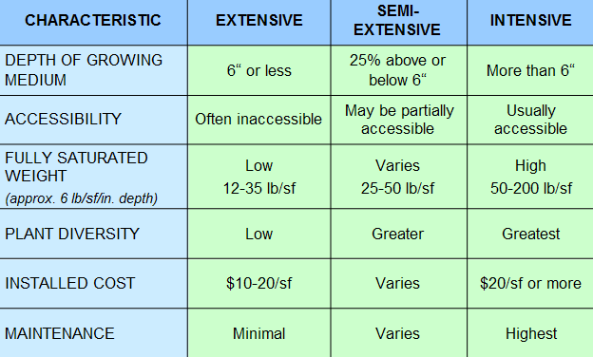
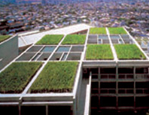
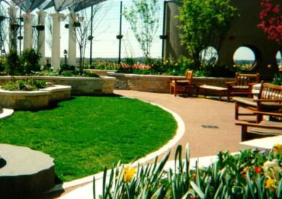
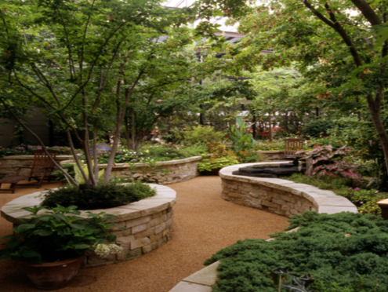
What Type of Green Roof?
Project Overview
LEED Status
Owner Assessment
Glazing Analysis
Green Roof Analysis
Potential Status
Questions
(Source: Green Roofs for Healthy Cities)
Extensive Roof Semi-Intensive Roof Intensive Roof
(Source: Sika Sarnifil)

Slide 27
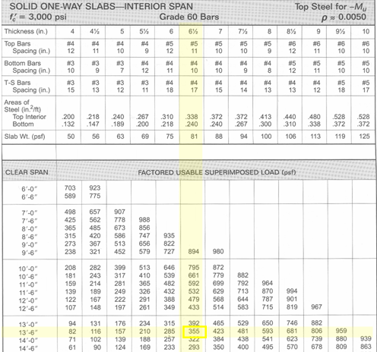
Structural Design
One-Way Structural Slab Design
30’-0” x 30’-0” typical bay with 24” x 24” columns
Design based on Concrete Reinforcing Steel Institute Design Handbook, 2002
Project Overview
LEED Status
Owner Assessment
Glazing Analysis
Green Roof Analysis
Potential Status
Questions
Slab Design:
100 PSF Live Load
60 PSF Dead Load
Factored Load = 254 PSF
Min. Thickness = l/28 = 15’/28 = 6.4”
Deflection Check: OK
Crack Control/Spacing: OK
SLAB DESIGN THICKNESS: 6.5”
Top Bars, #5 @ 11”
Bottom Bars, #4 @ 10”
Temperature Bars, #4 @ 17”

Slide 28
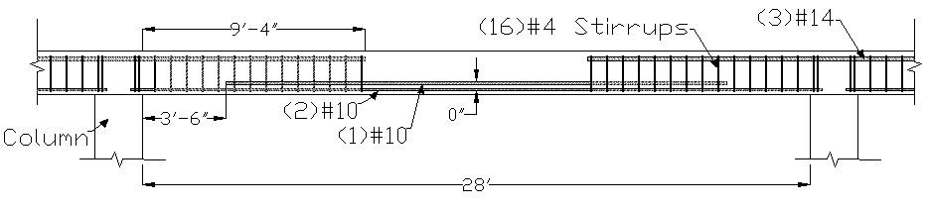
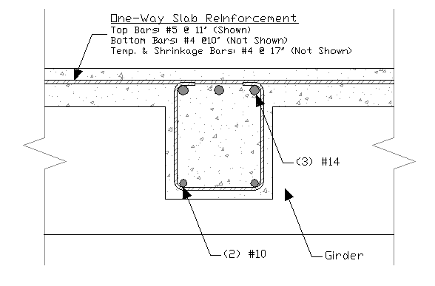
Beam Design:
100 PSF Live Load
141 PSF Dead Load
Factored Load = 368 PSF
Factored Line Load = 5.927 KLF
Beam Size: 18” x 22”
Bottom Bars, (2) #10 [l_{n} + 12”]
(1) #10 [0.875 l_{n}]
Top Bars, (3) #14
Open Stirrups, (16)#4: 1@2”, 15@9”
Project Overview
LEED Status
Owner Assessment
Glazing Analysis
Green Roof Analysis
Potential Status
Questions

Slide 29
Girder Design:
Estimate Factored Girder Load,
Moment from Mid-Span Concentrated Load (Beam)
Equivalent Uniform Load,
Total Factored Load (for –M_{u}),
Factored Positive Moment,
Total Factored Load (for +M_{u}),
Project Overview
LEED Status
Owner Assessment
Glazing Analysis
Green Roof Analysis
Potential Status
Questions

Slide 30
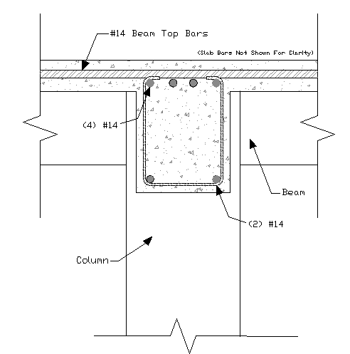
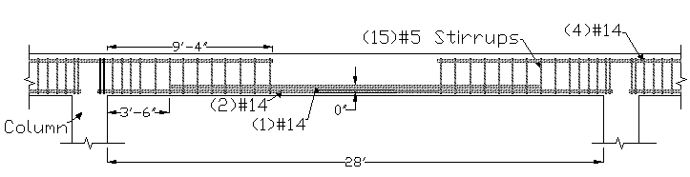
Girder Design:
Project Overview
LEED Status
Owner Assessment
Glazing Analysis
Green Roof Analysis
Potential Status
Questions
Girder Size: 20” x 28”
Bottom Bars, (2) #14 [l_{n} + 12”]
(1) #14 [0.875 l_{n}]
Top Bars, (4) #14
Open Stirrups, (15)#5: 1@2”, 5@8”, 9@11”
Torsion Check: OK
Shear Check: OK
Bottom Bar Moment Check: OK

Slide 31
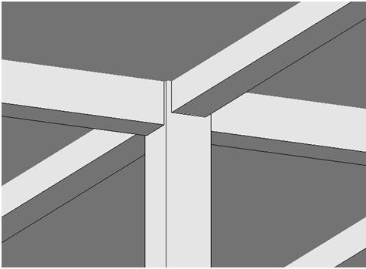
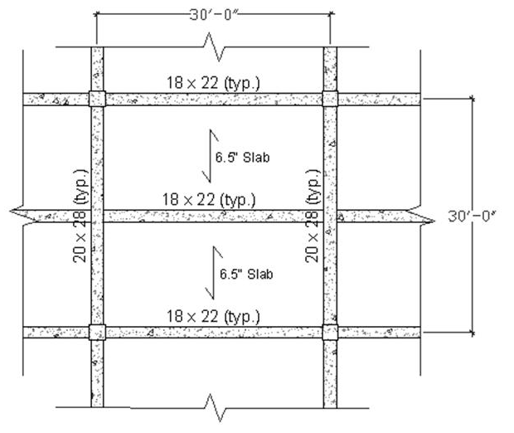
Roofing One-Way Slab Structural Redesign:
6.5” Slab
18” x 22” Beams
20” x 28” Girders
Project Overview
LEED Status
Owner Assessment
Glazing Analysis
Green Roof Analysis
Potential Status
Questions

Slide 32
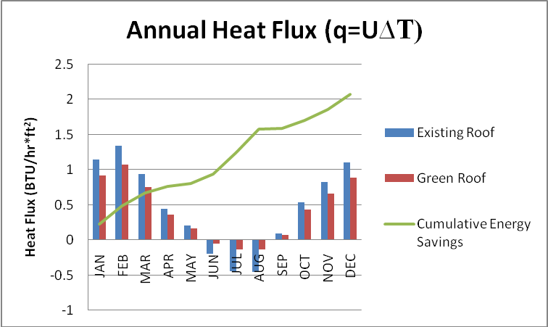
Energy Savings:
Project Overview
LEED Status
Owner Assessment
Glazing Analysis
Green Roof Analysis
Potential Status
Questions
Q = Area * Cum. Annual Savings * Hours Per Day * Days Per Year
Q = (24,000 ft²) * (2.073 BTU / Hr. * ft²) * 24 Hrs/Day * 365.25 Days/Year
Q = 436,126,032 BTUs/Year
Annual Energy Savings: $2,073

Slide 33
Cost Implications:
Existing Roof: 32,000 SF EPDM roofing membrane
Proposed Roof: 8,000 SF EPDM roofing membrane and 24,000 SF Green Roof
Project Overview
LEED Status
Owner Assessment
Glazing Analysis
Green Roof Analysis
Potential Status
Questions
Existing EPDM Roof System
32,000 SF @ $9.80/SF = $313,600
Total Cost = $313,600
Average Cost = $9.80/SF
Green Roof Redesign
8,000 SF @ $9.80/SF = $78,400
24,000 SF @ $22.50/SF = $540,000
Total Cost = $618,400
Average Cost = $19.32/SF
Additional Cost: $304,800

Slide 34
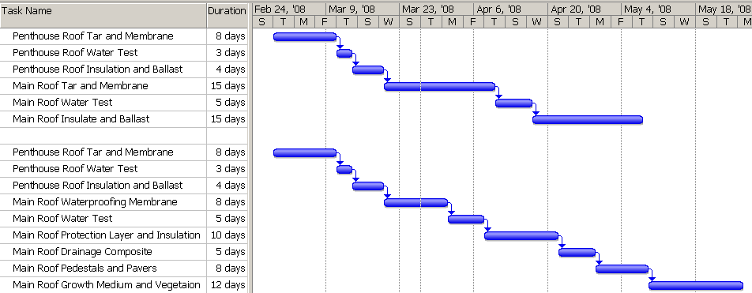
Schedule Implications:
Existing Roof: 50 day schedule
Proposed Roof: 63 day schedule
Project Overview
LEED Status
Owner Assessment
Glazing Analysis
Green Roof Analysis
Potential Status
Questions
Proposed Existing
Roofing Schedule Impact: ≈ 2.5 week increase

Slide 35
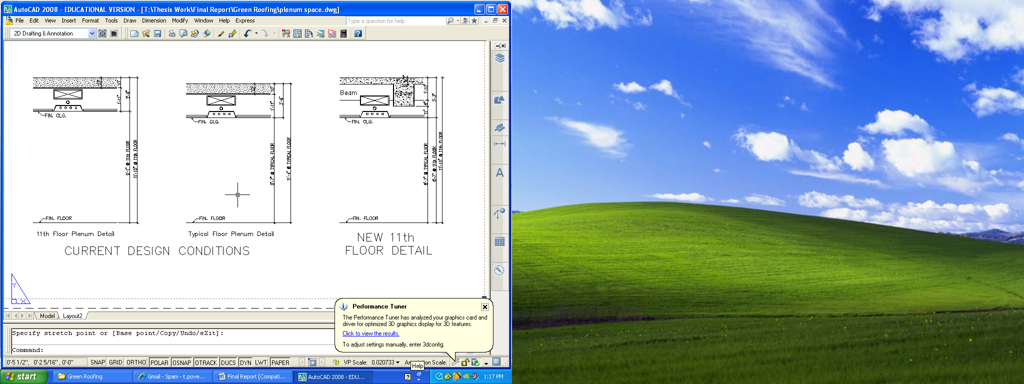
Plenum Space Implications:
Roof height can not be raised as a result of Washington, DC height restrictions.
Ways of Remedying the Plenum Space Issue:
1. Resize ducts to fit below proposed girders.
2. Lower the finished ceiling height.
3. Provide cutouts and reinforcing in the girders to accommodate ducts.
Project Overview
LEED Status
Owner Assessment
Glazing Analysis
Green Roof Analysis
Potential Status
Questions
Existing Condition
Proposed Condition

Slide 36
LEED Impact:
Project Overview
LEED Status
Owner Assessment
Glazing Analysis
Green Roof Analysis
Potential Status
Questions

Slide 37
Equivalent Uniform Annual Cost Analysis
Project Overview
LEED Status
Owner Assessment
Glazing Analysis
Green Roof Analysis
Potential Status
Questions
Objective:
• As was discovered in the owner assessment , financial profitability is a primary concern for many companies pursuing LEED accreditation. How do the proposed changes perform financially?

Slide 38
Equivalent Uniform Annual Cost Analysis
Project Overview
LEED Status
Owner Assessment
Glazing Analysis
Green Roof Analysis
Potential Status
Questions
(Assumes an annual interest rate of 7%.)
EUAC_{Existing} = $313,600(A/P, 7%, 20) + $8,000 + $322,924(A/P, 7%, 25)
= $65,310
EUAC_{Proposed} = $618,400(A/P, 7%, 40) + $14,000 -$2,903 +$359,344(A/P, 7%, 25) - $12,712
= $72,000
$6,690 Annually = Less than $0.01 per month per square foot
Recommendation:
Pursue sustainable design objectives by incorporating a green roof and an alternative glazing type.

Slide 39
Potential LEED Status
Project Overview
LEED Status
Owner Assessment
Glazing Analysis
Green Roof Analysis
Potential Status
Questions

Slide 40
Potential LEED Status
Project Overview
LEED Status
Owner Assessment
Glazing Analysis
Green Roof Analysis
Potential Status
Questions
23 pts
28 pts
34 pts
45 pts
61 pts
Existing |  |  |  |  |  |  |  |  |  |  |  |  |  |  |  |  |  |  |  |  |  |  | Certified |  |  |  |  | Silver |  |  |  |  |  | Gold |  |  |  |  |  |  |  |  |  |  | Platinum
Proposed |  |  |  |  |  |  |  |  |  |  |  |  |  |  |  |  |  |  |  |  |  |  | Certified |  |  |  |  | Silver |  |  |  |  |  | Gold |  |  |  |  |  |  |  |  |  |  | Platinum
Likely Points
Possible Points

Slide 41
Existing LEED Status
Project Overview
LEED Status
Owner Assessment
Glazing Analysis
Green Roof Analysis
Potential Status
Questions
LEED® Green Building Rating SystemTM For Core & Shell Development, v2.0
Sustainable Sites (SS)
1.0 Site Selection
2.0 Development Density & Community Connectivity
4.1 Public Transportation
7.1 Heat Island Effect, Non-Roof
LEED® Accreditation:
4 Points
Achieved
2 Points Possible
Water Efficiency (WE)
5 Possible Points
Energy & Atmosphere (EA)
14 Possible Points
Materials & Resources (MR)
11 Possible Points
Indoor Environmental Quality (EQ)
8.1 Daylight & Views: Daylight 75% of Spaces
8.2 Daylight & Views: Views for 90% of Spaces
Innovation & Design Process (ID)
5 Possible Points

Slide 42
Potential LEED Status
Project Overview
LEED Status
Owner Assessment
Glazing Analysis
Green Roof Analysis
Potential Status
Questions
LEED® Green Building Rating SystemTM For Core & Shell Development, v2.0
Sustainable Sites (SS)
1.0 Site Selection
2.0 Development Density & Community Connectivity
4.1 Public Transportation
6.1 Storm Water Design: Quantity Control
7.1 Heat Island Effect, Non-Roof
7.2 Heat Island Effect, Roof
LEED® Accreditation:
10 Points
Achieved
7 Points Possible
Water Efficiency (WE)
1.1 Water Efficient Landscaping: Reduce by 50%
Energy & Atmosphere (EA)
1.0 Optimize Energy Performance
Materials & Resources (MR)
4.1, 4.2 Recycled Content
5.1, 5.2 Regional Materials
Indoor Environmental Quality (EQ)
8.1 Daylight & Views: Daylight 75% of Spaces
8.2 Daylight & Views: Views for 90% of Spaces
Innovation & Design Process (ID)
1.1 Innovation in Design

Slide 43
Acknowledgements
Project Overview
LEED Status
Owner Assessment
Glazing Analysis
Green Roof Analysis
Potential Status
Questions
Brookfield Properties James Berkon
Davis, Carter, Scott Design Ernest Ulibarri
James G. Davis Construction Corporation
Dominic Argentieri Ron Juban
Marybeth Bulgaris
Pennsylvania State University
Craig Dubler Professor Kevin Parfitt
Professor Robert Holland Andreas Phelps
Dr. Michael Horman Dr. David Riley
Moses Ling Monica Steckroth
Dr. John Messner
Sika Sarnafil Ryan Shaughnessy
Viracon, Inc. Alissa Schmidt

Slide 44

Questions
Project Overview
LEED Status
Owner Assessment
Glazing Analysis
Green Roof Analysis
Potential Status
Questions

